Slide 1


Economy: 6 pillars + theory + current + BES17 (pre cum Mains)
1.Banking, Fin, Insur.
6.HRD
2.Budget
3.BoP & Intl. Trade
4.Sectors
5.Infra
V1:c3,4
V1:c2,3, 6,9,11(GST),12,13
V1c:5
V1c:7,11(Agri)
V1c:10
v1c:12, 14; Budget^Rail
BES173: theory, current
BoP-Current
BoP-Capital
Orgs
Survey Ch.5

Slide 2
International Organizations
WW2: Bretton Woods Conference
GATT-> WTO (Remove Trade Barriers)
Tariff
Non-Tariff
IMF
World Bank (5)
Exchange rate stability
Help Poor Countries

Slide 3
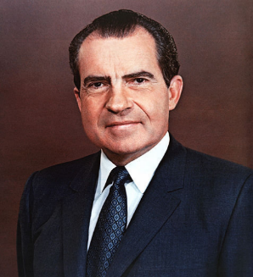
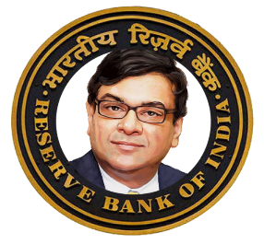



IMF: Gold Standard Exchange Rate
All other currencies pegged against Dollar.
US $ “Global Reserve currency”
1 Rs. = $ 0.30
1 Dollar
Dollar is pegged against Gold.
“Gold convertibility”.
0.88 gms Gold
Notes:
(+1/-1)% band

Slide 4
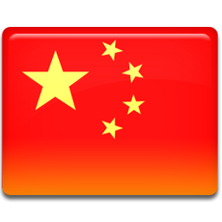
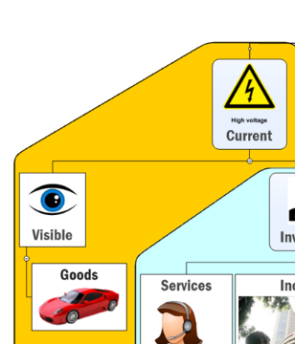





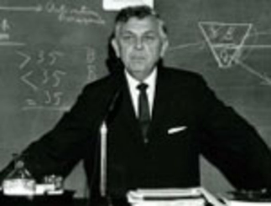


Gold Standard System: Triffin Dilemma
$1= 0.88gms Gold
..
$2= 0.88gms Gold
but USA can’t do, else foreigners start loosing ‘faith’ in their dollar’s purchasing power.
At some point, the game will become unsustainable, and Bretton Woods system will collapse!
TRADE DEFICIT
Gold is ‘finite’ commodity,
with time,Market price ▲
American Economist Robert Triffin
Notes:
American economist prof. Robert Triffin

Slide 5


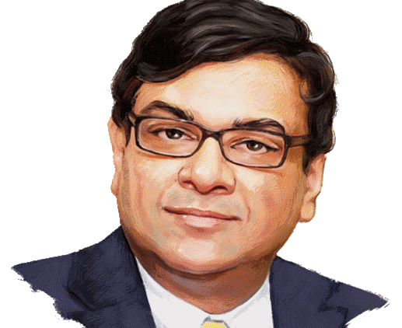

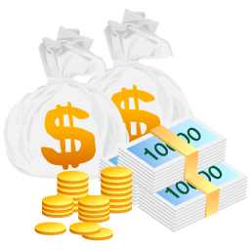
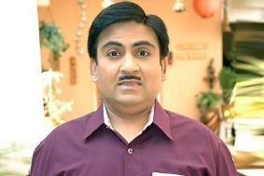

1970s
Even some central bankers had more $$ in forex reserve than USA had gold.
Hey I won’t allow this “Gold convertibility”!...
Besides, need free hand to print dollars for cold war & arm race
So Gold pegged fixed exchange rate…stopped, by Nixon.
73: floating exchange
US Treasury: $35 = 1 Ounce Gold
Give dollar, get gold, sell in market
Market price 1 oz= >$40
Notes:
1 ounce = 28.35 gm
1 gm = (1/0.88) $
1 ounce = 28 x (1 / 0.88) $ = $32

Slide 6
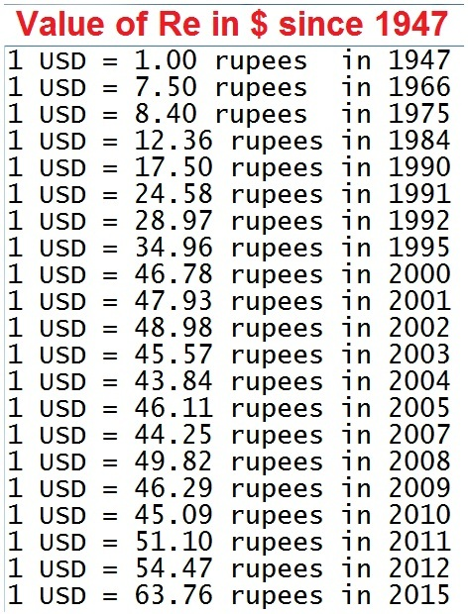
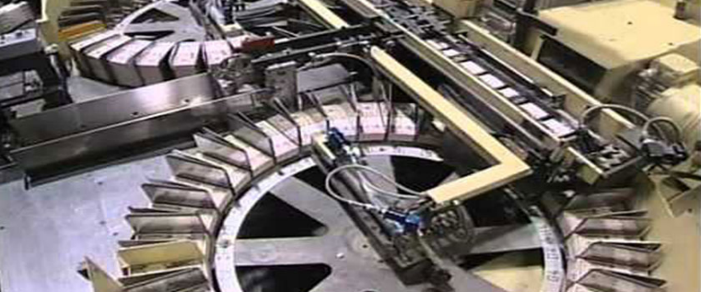
Currency standard vs exchange rate regime [don’t confuse]
1935-56
40% gold to the value of currency issued.
1956
Minimum foreign reserves system
Keep 115 cr. Worth gold + Rs. 400 crores worth Foreign security = 515 cr.
1995:
Rs. 115 crore worth gold.
"Managed paper currency standard".
Print as much as you want. (but has to be backed by “financial assets” i.e. foreign currencies or bonds etc.)
IMF Gold Standard & Fixed Exchange Rate
Fixed exchange
DEVALUATION
Managed float
Depreciation
Notes:
Banking dept
T-bills, G-sec buying->
Coin, Rs.1 note and small coins are isued by central Government but distribution by RBI

Slide 7
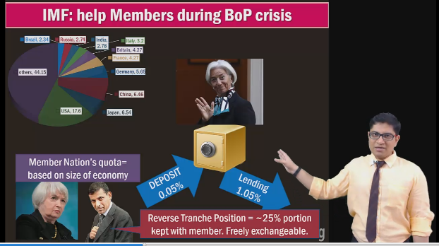
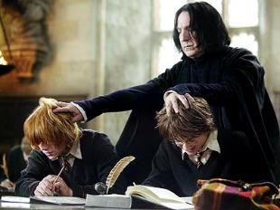
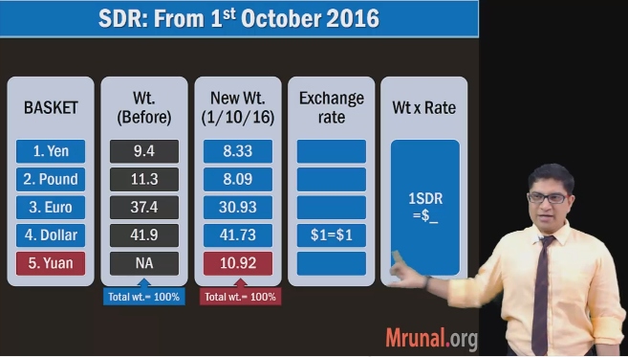
Gold std sys: IMF SDR->Dollar->Gold hence SDR “Paper Gold”
SELF Study: BES163- IMF reform.
Video Link
Notes:
Quota reforms.

Slide 8
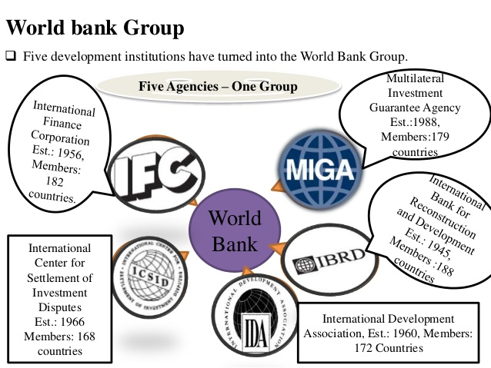
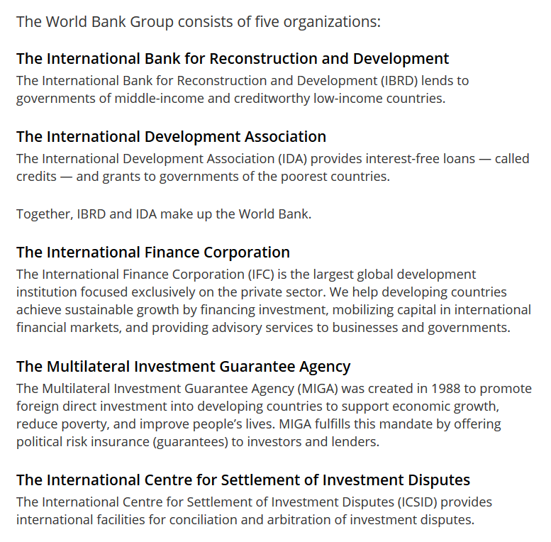

Slide 9

International Organizations
WW2: Bretton Woods Conference
GATT-> WTO
[1/1/95, Marrakesh Treaty, Morocco. India founding member]
Tariff
Non-Tariff
IMF
World Bank (5)
Exchange rate stability
Help Poor Countries
WTO Aims to Reduce barrier to international Trade…2 types

Slide 10

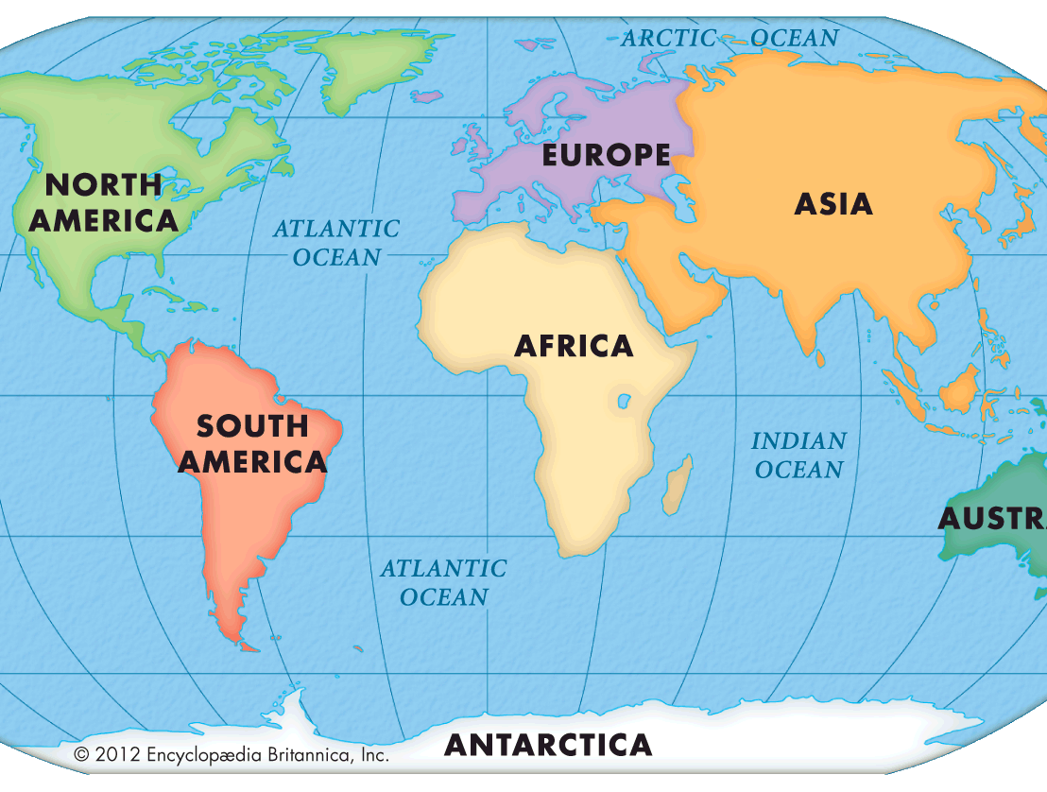

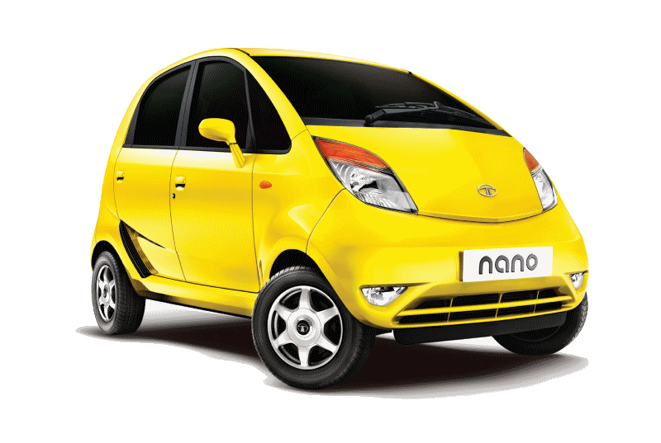
Tariff Barriers: all countries want to protect local business
GATT
General Agreement on Tariffs and Trade
GATS
General Agreement on Trade in Services
Detroit Cars: 0% excise
Indian Cars: 20% Custom duty

Slide 11
Non-Tariff Barriers: all countries want to protect local business
SPS [food]
Sanitary and Phytosanitary Measures (e.g. pesticides residue, fruit fly)
TBT [non-food]
Technical barriers to trade
Detroit Cars: 10% excise
Subsidies
Electricity, Steel, rubber
“EPFO” social security payment
SCM (Non-food)
AoA Agreement on Agro
-> Subsidies [BOXES]
Subsidies and Countervailing Measures
Indian Cars: 10% Custom
USA govt car purchase : can’t fill TENDER
Car paint: lead, arsenic _%
Must have ‘airbags’
Glasses anti-UV coating

Slide 12
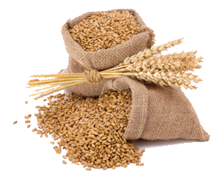
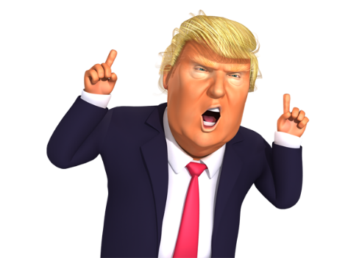
WTO AoA->Subsidies “BOXES” (Classification)
Green box (Allowed)
R&D, training, pest control etc.
Amber: disruptive (LIMITS)
Fertilizer, Electricity, Diesel, MSP
Blue box (Allowed)
Not increase with production
Iceland, Slovenia etc.
Encourage farmer to produce more

Slide 13

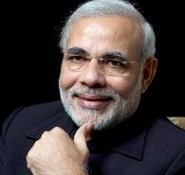

WTO->AoA-> Amber Box: Production in 86-87..
De-minimum Level
$100 billion
5% (1st World)
$5 Bn subsidies allowed
$10 billion
10% (3rd world)
$1 billion
But our 10% is small than your 5%, inflation unaccounted, poverty- farmers ☹
Bali Summit (2013) “Peace Clause”.. Won’t hear cases till 2017. continue food security, PDS programs
If more subsidies, then other members can “impose” Barriers, or approach WTO dispute resolution..

Slide 14

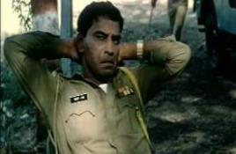
Trade Facilitation agreement: 2/3rd members needed to ratify
Customs Clearance
9th Conference-
Trade Facilitation Agreement (TFA)
Bali Summit, Dec 2013
To be Effective from 2015 2017
BEFORE
AFTER
Apply, pay fees/taxes Online
Single window for docu.-check
Faster clearance to perishable goods
No middlemen/agent needed
Coordination bodies @ Nat.+Intl.level
BENEFIT?
▲$1 Trillion GDP
▲ 21 million jobs
2016: India signed, ratified
National Committee on trade facilitation: boss: cabinet Secretary
Steering comm: Commerce & Revenue Secretary (IAS) jt. chair
2017, Feb: came into into effect
Refused to sign in Bali Summit (2013) because of “food subsidy” issue but happy after “Peace Clause”
Notes:
Trade Facilitation Agreement (TFA) to ease custom norms
Need 2/3rd ratification (108/162) but so far 69 ratified
India RATIFIED, will setup a National Committee on Trade Facilitation (NCTF)
NCTF to be jointly chaired by the commerce and revenue secretary.

Slide 15
Which of the following WTO agreements are meant to reduce the Non-Tariff Barriers to International trade?
SPS: Sanitary and Phytosanitary Measures agreement
TBT: Technical Barriers to trade agreement
Trade Facilitation agreement
Answer Choices
a) Only 1 and 2 (b) Only 2 and 3
c) Only 1 and 3 (d) None of them
Hint: delay in giving custom clearance and similar bureaucratic red tapes are examples of non- tariff barriers.

Slide 16
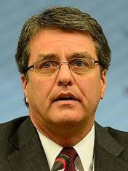

World Trade Organization-Structure
latest Afghanistan (2016, June formally joined)
WTO Structure
Ministerial Conference
Secretariat
General Council
164 MEMBERS
Every 2 yr
Appoint DG
Trade agreements
Day2 Day
Dispute Settlement
Geneva
Roberto Azevêdo (Brazil), 4 years, reappoint

Slide 17
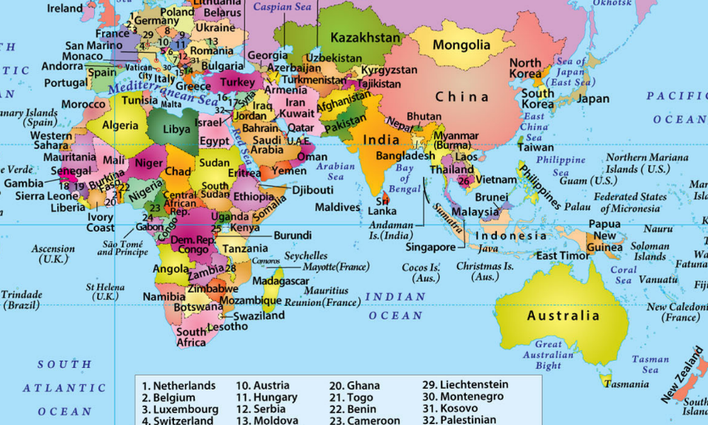
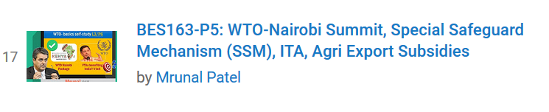
WTO Ministerial conference each 2 years
HQ: GENEVA
‘01: Doha “Round”
‘13: Bali,9th
TFA
“Peace Clause”
‘15: Nairobi,10th
1st time in Africa
Self-study Video Link

Slide 18
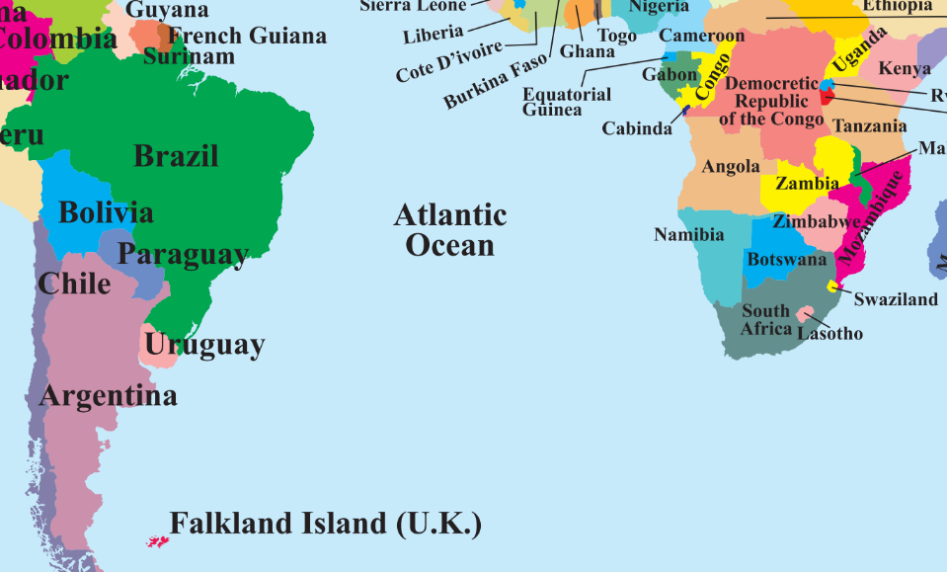
WTO Ministerial conference each 2 years
‘15: Nairobi,10th
1st time in Africa
’2017, Dec: Buenos Aires, (11th) but 1st time in America
But mains-2018 will be over before that! So you’re ‘saved’. However, theHindu will keep writing articles before the summit on issue. But they’d be in context of peace clauses’ permanent resolution.

Slide 19
Which of the following pairs are correct about the summits held / to be held in 2017?
Pravasi Bharatiya Diwas: Bengaluru
WTO: Buenos Aires, Argentina
UNFCCC: Bonn, Germany
Answer Choices
a) Only 1 and 2 (b) Only 2 and 3
c) Only 1 and 3 (d) All of them

Slide 20
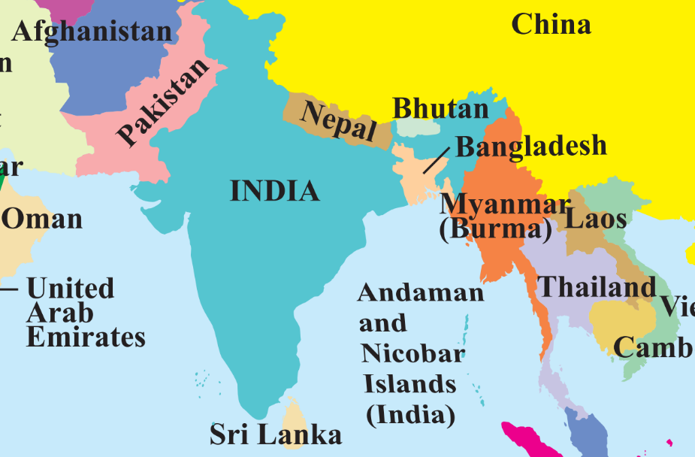
Misc: WTO: GATT, GATS: MFN? Most Favoured Nation?
Bhutan mango import 0%
If we give Pak MFN status, then same for Pak Mangoes
1997: India gave MFN status to Pak
They’re yet to give. Opposition from their farmers and textile industry.

Slide 21
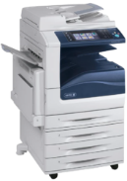
WTO : Misc. agreements
TRIPS (WTO)
Trade Related Intellectual Property Rights (TRIPS)
TRIMs (WTO)
Trade-Related Investment Measures on foreigners.
Must protect for each other copyright, patent etc.
e.g. at least 1 screw in Xerox machine must be Indian! Or suppose Xerox allowed to setup plant in India- but not allowed currency convertibility [import-export, profit-capital ☹]
“domestic content”, “Forex restrictions”, “Quota” requirement.
USA: “Special 301 Report” :
for country that don’t protect its IPR
priority watch list [India, China etc] >>watch list..

Slide 22
International Organizations: SELF STUDY
BRICS Bank (New Dev. Bank), Shanghai | AIIB, Beijing
6th summit Fortaleza 2014=>ops.to start from 2016 | AIIB: Asian infra investment bank 2014: MoU signed. start work from ’15. 2014: China+21 member MoU=>2015 starts.
Five members, equal voting power (not in IMF or AIIB.) | China + 21 members. S.Korea, Aussie did not join.
capital: 10 million x 5 members (hence equal voting) | 100 billion capital=>Shareholding based on GDP. Voting power based on shareholding. China:1st, India: 2nd. But, China to dilute shareholding when new members come.
3 function: loan for infra, sus.Development, BoP crisis. | as name suggest: infra. investment projects Structure: Board of governors >> directors >> President (HQ: Beijing)
For BoP crisis: separate contingency reserve: 100 billion. China gave highest. | 2013: Jinping ‘s idea: make profit from forex reserve+ Silkroad finance+ U$ domination reduce.
WW2: Bretton Woods Conference
GATT-> WTO
[1/1/95, Marrakesh Treaty, Morocco. India founding member]
Tariff
Non-Tariff
IMF
World Bank (5)
Exchange rate stability
Help Poor Countries
WTO Aims to Reduce barrier to international Trade…2 types

Slide 23
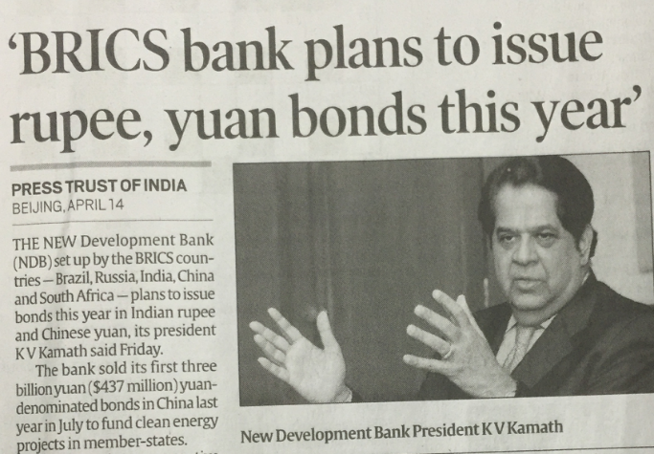
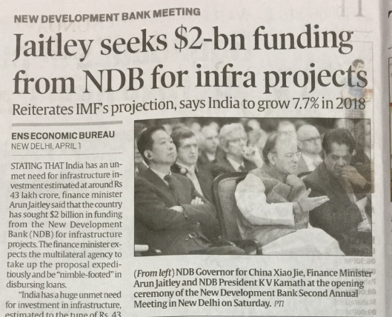

Slide 24
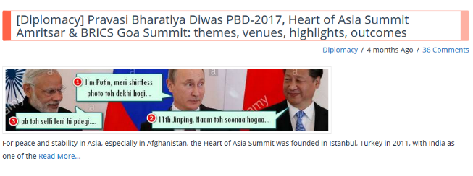
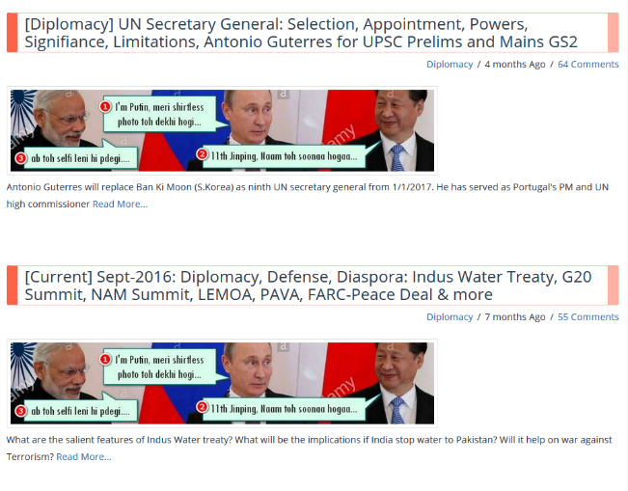
http://mrunal.org/category/diplomacy

Slide 25
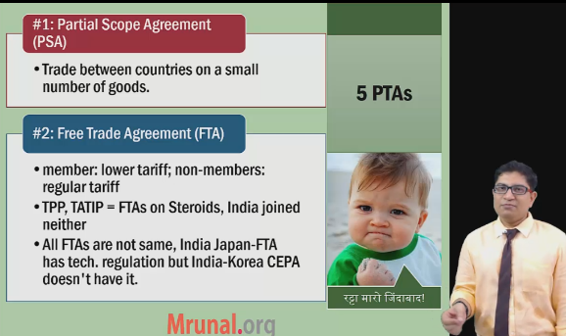
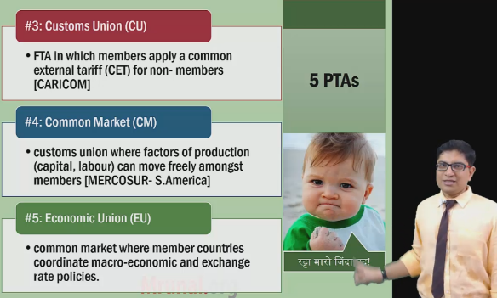
Trade Agreements
Self-study Video Link

Slide 26
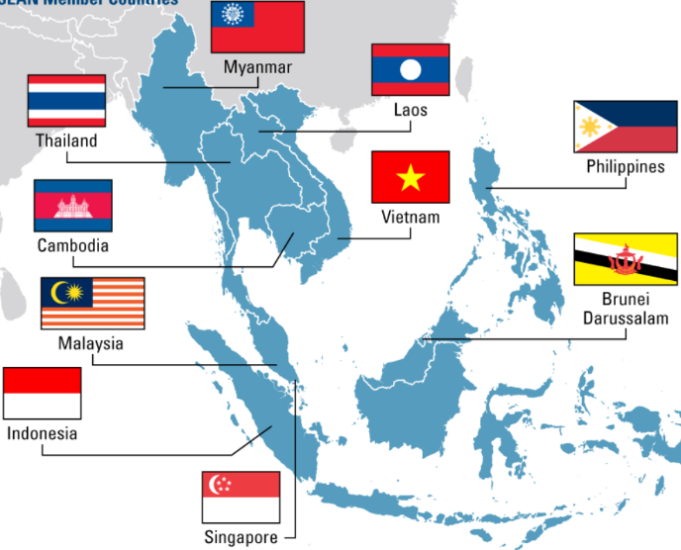

Association of South East Asian Nations (10)
+ ASEAN FT Partners
China, India
Jap, Korea
Aus., NZ
= Regional Comprehensive Economic Partnership (RCEP)
Multi-lateral FTA
India ASEAN FTAs
In Goods (2009)
In Services & Investment (2015): 8+1 Indonesia + 1 Philippines
Notes:
FTA in Goods: 2009 sign ‘10 start
FTA in services: 2014= 9/10 ASEAN signed
Philippines: apprehensive of Indian IT/BPO competition.
FTA Services WEF: 1 July 2015
FTA in services and investment=8+1+1 pattern
1: with Philippines to safeguard their IT/BPO
1: with Indonesia to safeguard their service sector
8: agreements with remaining

Slide 27
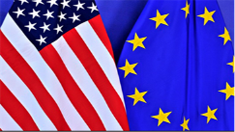
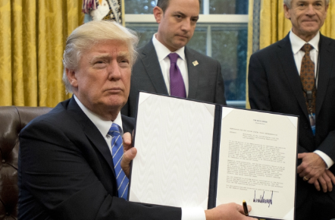

Regional Trade Agreements: FTA on “steroids” [investment, labour]
Transatlantic Trade and Investment Partnership (TTIP): US-EU, Trump positive
Regional Comprehensive Economic Partnership (RCEP)
China, India, ASEAN etc...
TPP: Trans Pacific Partnership
Trump withdraws
में TPP पे साइन नही करूंगा.

Slide 28
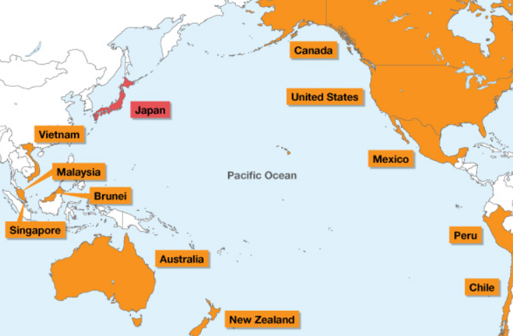

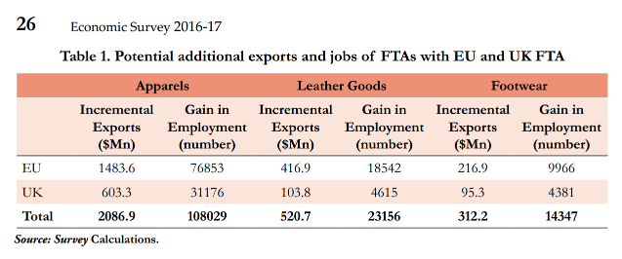
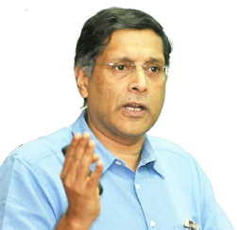
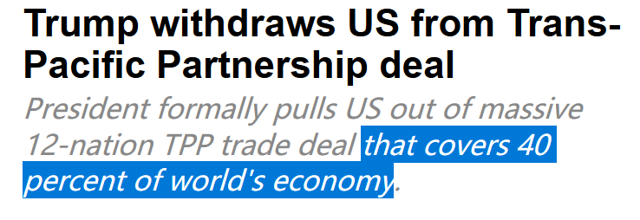
TPP: 12 members :USA + Canada + 10 Asia-Pacific
NAFTA
Our local farmers, businessmen will be hurt ☹ even NAFTA I’ll rethink
Yes..yes..yes Good, because now WTO will gain prominence, where LDC have equitable voice.
Companies will setup shops in Mexico or Vietnam for cheap labour, then export to USA, we can’t even put heavy tax on them #SAD
Will study that in BES17-”4”

Slide 29

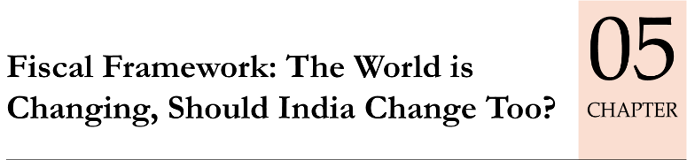
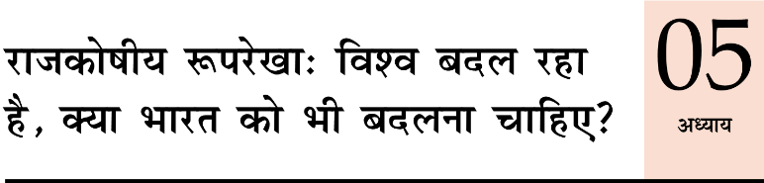
Economy: 6 pillars + theory + current + BES17 (pre cum Mains)
1.Banking, Fin, Insur.
6.HRD
2.Budget
3.BoP & intl. Trade
4.Sectors
5.Infra
V1:c3,4
V1:c2,3, 6,9,11(GST),13
V1c:5
V1c:7,11(Agri)
V1c:10
v1c:12, 14; Budget^Rail
BES173: theory, current
BoP-Current
BoP-Capital
Orgs
Survey Ch.5

